Slide 1

Flood Prediction and
Dry Ration
Optimization based on Kelani River Basin

Slide 2

Research Problem

Slide 3
Research Problem
Floods are one of the most common types of disasters that affect Sri Lanka.
The number of people affected by floods has reached over 120,000 in June 2018.
Floods can interrupt human lives in many ways such as loss of lives, displacement of people, destruction of houses and properties etc.
Spreading waterborne diseases like dengue, leptospirosis and diarrhea.
At present, there are plenty of applications to forecast floods, but there's a lack of proper application to predict and warn floods in Sri Lanka.
Our main concern is to predict flood disasters around kaduwela area based on the Kelani river to inform and warn public about the risk and optimizing flood relief.

Slide 4
Objectives

Slide 5
Objectives
To make the use of historic data and real time data in order to predict flood disasters around Kalani River Basin.
To inform people in Kaduwela area on the risk exposure to floods and where they should find safe locations .
To optimize the amount of dry rations need to be sent to the flood affected people.

Slide 6
Research Area

Slide 7
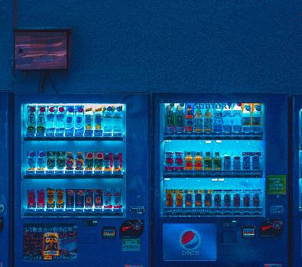
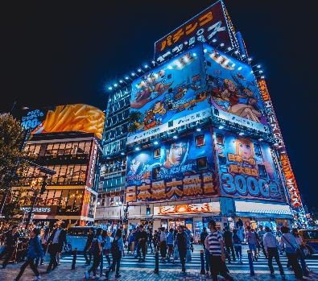

Research Areas
Data Science.
Machine Learning.
Image Processing.
Optimization.
Artificial Intelligence.

Slide 8
Solution Proposed

Slide 9
Solution Proposed
Basically focused on prediction of floods in Kaduwela area based on Kelani river basin and dry ration optimization.
With the proposed application,
Flood forecasting including water level prediction
Time prediction according to the rainfall
Flood simulation
Optimizing the amount of dry rations need to be sent

Slide 10
Technologies to be used

Slide 11
Technologies to be used
Machine Learning, Optimization, Artificial Neural Network, GIS and Data Mining
Dashboard
Frontend - Angular
Backend - Node JS
Databases – NoSQL
Mobile App - Ionic

Slide 12

About Us
Supervisor:
Dr. Pradeepa Samarasinghe.
Group Members:
Dilini H.O. Pathirana.
G.C. Laveesha Chandrasiri.
M.D.S Jayasekara.
D.H. Vishara Dilmi.

Slide 13
Thank You

